Slide 1
Intelligent Agents Structure & Environment

Slide 2
Definition
An agent is anything that can be viewed as perceiving its environment through sensors and acting upon that environment through actuators.
Agent = Architecture+ Program
Architecture = the machinery that an agent executes on
Agent Program = an implementation of an agent function.

Slide 3
Cont…
Human agent:
eyes, ears, and other organs for sensors;
hands, legs, mouth, and other body parts for actuators
Robotic agent:
cameras and infrared range finders for sensors
various motors for actuators
Software agent:
keystrokes, file contents as sensory input and act on those inputs and display output on the screen.

Slide 4
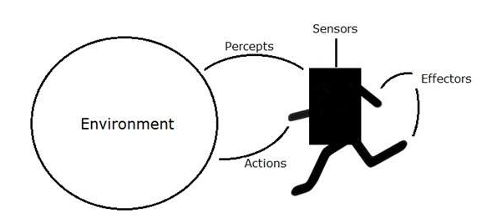
Terms
Sensor: Sensor is a device which detects the change in the environment and sends the information to other electronic devices. An agent observes its environment through sensors.
Actuators: Actuators are the component of machines that converts energy into motion. The actuators are only responsible for moving and controlling a system. An actuator can be an electric motor, gears, rails, etc.
Effectors: Effectors are the devices which affect the environment. Effectors can be legs, wheels, arms, fingers, wings, fins, and display screen.

Slide 5
RATIONALITY
Four factors affecting rational at any given time is:
The performance measure that defines the criterion of success
The agent’s prior knowledge of the environment
Best possible actions that an agent can perform.
The agent’s percept sequence to date

Slide 6
RATIONAL AGENTS
Rational Agent: For each possible percept sequence, a rational agent should select an action that is expected to maximize its performance measure, given the evidence provided by the percept sequence and whatever built-in knowledge the agent has.

Slide 7
RATIONAL AGENTS
Rationality is distinct from omniscience (all-knowing with infinite knowledge)
Agents can perform actions in order to modify future percepts so as to obtain useful information (information gathering, exploration)
An agent is autonomous if its behavior is determined by its own experience (with ability to learn and adapt)

Slide 8
Cont…
A rational agent is an agent which has clear preference, models uncertainty, and acts in a way to maximize its performance measure with all possible actions.
A rational agent is said to perform the right things. AI is about creating rational agents to use for game theory and decision theory for various real-world scenarios.

Slide 9
NATURE OF ENVIRONMENT
INTRODUCTION
Must decide and think about “Task environment”
Task environments are essentially the “problems” to which rational agents are the “solution”
SPECIFYING THE TASK ENVIRONMENT
It involves grouping the following measuring factors together under the heading of the “Task environment”
PEAS (Performance, Environment, Actuator, Sensors)

Slide 10
PEAS
PEAS is a type of model on which an AI agent works upon. When we define an AI agent or rational agent, then we can group its properties under PEAS representation model. It is made up of four words:
P: Performance measure
E: Environment
A: Actuators
S: Sensors

Slide 11
PEAS
PEAS: Performance measure, Environment, Actuators, Sensors
Must first specify the setting for intelligent agent design
Consider, e.g., the task of designing an automated taxi driver:
Performance measure Environment
Actuators
Sensors

Slide 12
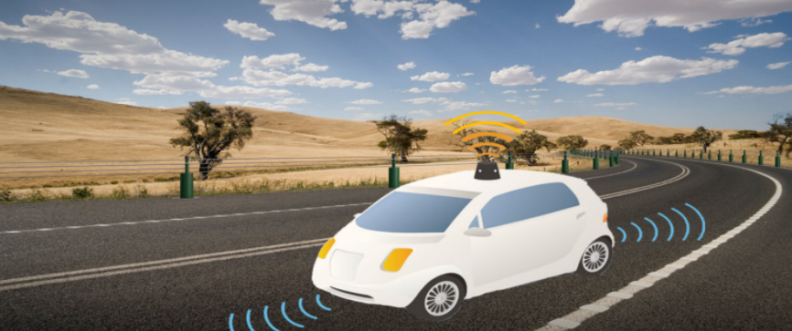
Example

Slide 13
PEAS
Must first specify the setting for intelligent agent design
Consider, e.g., the task of designing an automated taxi driver:
Performance measure: Safe, fast, legal, comfortable trip, maximize profits
Environment: Roads, other traffic, pedestrians, customers
Actuators: Steering wheel, accelerator, brake, signal, horn
Sensors: Cameras, sonar, speedometer, GPS, odometer, engine sensors, keyboard

Slide 14
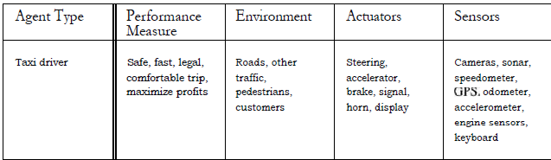
PEAS description of the task environment for an automated Taxi

Slide 15
PEAS
Agent: Medical diagnosis system
Performance measure: Healthy patient, minimize costs, lawsuits
Environment: Patient, hospital, staff
Actuators: Screen display (questions, tests, diagnoses, treatments, referrals)
Sensors: Keyboard (entry of symptoms, findings, patient's answers)

Slide 16
PEAS
Agent: Part-picking robot
Performance measure: Percentage of parts in correct bins
Environment: Conveyor belt with parts, bins
Actuators: Jointed arm and hand
Sensors: Camera, joint angle sensors

Slide 17
PEAS
Agent: Interactive English tutor
Performance measure: Maximize student's score on test
Environment: Set of students
Actuators: Screen display (exercises, suggestions, corrections)
Sensors: Keyboard

Slide 18
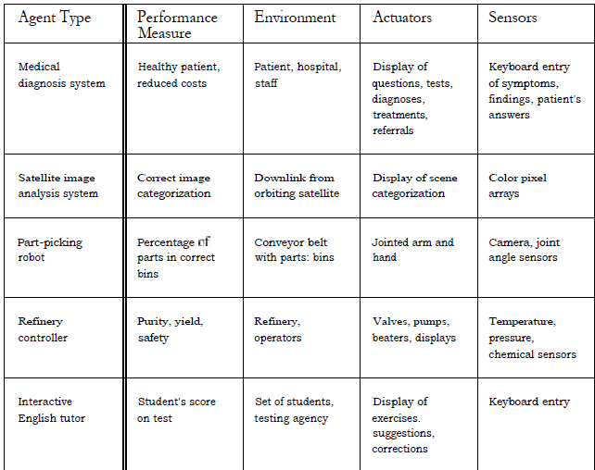
Examples of agent types and their PEAS descriptions

Slide 19
Environment Types
Fully observable vs Partially Observable
Static vs Dynamic
Discrete vs Continuous
Deterministic vs Stochastic
Single-agent vs Multi-agent
Episodic vs sequential

Slide 20
Environment types (or) Properties of Task environment
Fully observable (vs. partially observable): An agent's sensors give it access to the complete state of the environment at each point in time.
Deterministic (vs. stochastic(random probability): The next state of the environment is completely determined by the current state and the action executed by the agent. (If the environment is deterministic except for the actions of other agents, then the environment is strategic)
Episodic (vs. sequential): The agent's experience is divided into atomic "episodes" (each episode consists of the agent perceiving and then performing a single action), and the choice of action in each episode depends only on the episode itself.

Slide 21
Environment types
Static (vs. dynamic): The environment is unchanged while an agent is deliberating. (The environment is semi-dynamic if the environment itself does not change with the passage of time but the agent's performance score does)
Discrete (Vs. continuous): A limited number of distinct, clearly defined percepts and actions.
Single agent (Vs. multi-agent): An agent operating by itself in an environment.

Slide 22
Fully observable vs Partially Observable
If an agent sensor can sense or access the complete state of an environment at each point of time then it is a fully observable environment, else it is partially observable.
A fully observable environment is easy as there is no need to maintain the internal state to keep track history of the world.
Image Recognition
Driving Cars

Slide 23
Static vs Dynamic
If the environment can change itself while an agent is deliberating then such environment is called a dynamic environment else it is called a static environment.
Static environments are easy to deal because an agent does not need to continue looking at the world while deciding for an action.
Taxi driving is an example of a dynamic environment whereas Crossword puzzles are an example of a static environment.
Empty House
Playing football

Slide 24
Discrete vs Continuous
If in an environment there are a finite number of percepts and actions that can be performed within it, then such an environment is called a discrete environment else it is called continuous environment.(Time moves in fixed step).
A chess game comes under discrete environment as there is a finite number of moves that can be performed.
A self-driving car is an example of a continuous environment.

Slide 25
Deterministic vs Stochastic
If an agent's current state and selected action can completely determine the next state of the environment, then such environment is called a deterministic environment. (Next state is completely predictable)
A stochastic environment is random in nature and cannot be determined completely by an agent. (Next step has some uncertainty)
In a deterministic, fully observable environment, agent does not need to worry about uncertainty.
Tic Tac Toe game, Physical world

Slide 26
Single-agent vs Multi-agent
If only one agent is involved in an environment, and operating by itself then such an environment is called single agent environment.
However, if multiple agents are operating in an environment, then such an environment is called a multi-agent environment.
Maze game
Football that includes 10 players

Slide 27
Episodic vs sequential
In an episodic environment, there is a series of one-shot actions, and only the current percept is required for the action.
However, in Sequential environment, an agent requires memory of past actions to determine the next best actions.
Mail Sorting System
Chess game

Slide 28
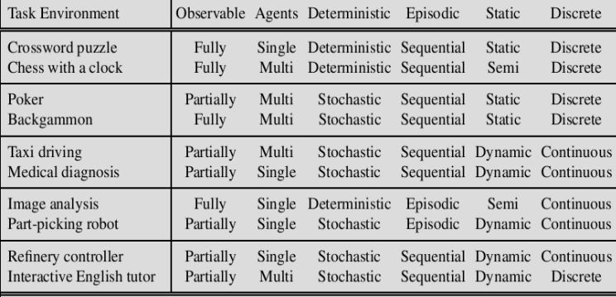
Cont…

Slide 29
Environment types
Chess with Chess without Taxi driving
a clock a clock
Fully observable Yes Yes No
Deterministic Strategic Strategic No
Episodic No No No
Static Semi Yes No
Discrete Yes Yes No
Single agent No No No
The environment type largely determines the agent design
The real world is (of course) partially observable, stochastic, sequential, dynamic, continuous, multi-agent

Slide 30
STRUCTURE OF AGENTS
How it (Intelligent Agents) inside work
Main job of AI is to design the agent program that implements agent function mapping percepts to actions
Program will run on some sort of computing device with physical sensors & actuators called architecture
Agent = architecture+program

Slide 31
Agent functions and programs
The Agent program is one which can take the current percept as input from the sensors and return an action to the actuators
The agent function can takes the entire percept history.
An agent is completely specified by the agent function mapping percept sequences to actions
One agent function (or a small equivalence class) is rational
Aim: find a way to implement the rational agent function concisely

Slide 32
Table-Driven Agent
Trivial agent program that keeps track of the percept sequence and then uses it to index into a table of action to decide what to do
The table represents explicitly the agent function that the agent program embodies
In order to build a rational agent, the designers must construct a table that contains the appropriate action for every possible percept sequence

Slide 33
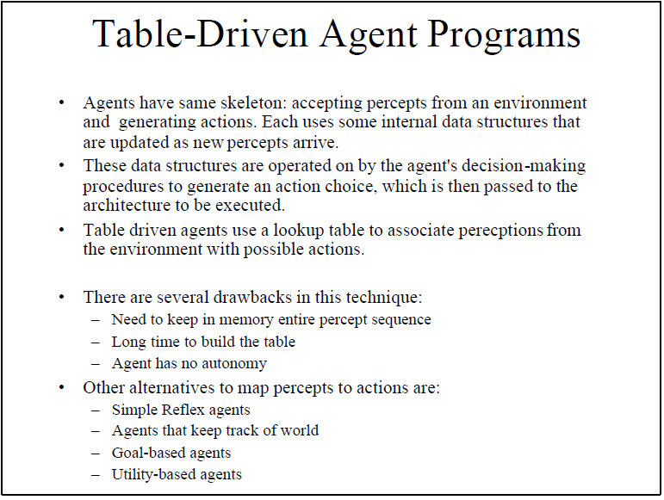

Slide 34
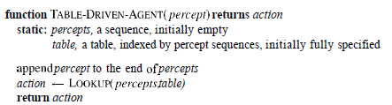
The TABLE-DRIVEN-AGENT program is invoked for each new percept and returns an action each time

Slide 35
Table-Driven Agent
Drawbacks:
Huge table
Take a long time to build the table
No autonomy
Even with learning, need a long time to learn the table entries

Slide 36
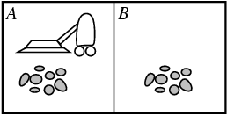
Agent program for a vacuum-cleaner agent
function REFLEX-VACUUM-AGENT ([location, status]) returns an action
if status = Dirty then return Suck
else if location = A then return Right
else if location = B then return Left
Percepts: location and contents, e.g., [A,Dirty]
Actions: Left, Right, Suck, NoOp

Slide 37
Agent types
Five basic types in order of increasing generality:
Simple reflex agents
Model-based reflex agents
Goal-based agents
Utility-based agents
Learning agent

Slide 38
Simple reflex agents
The Simple reflex agents are the simplest agents. These agents take decisions on the basis of the current percepts and ignore the rest of the percept history.
These agents only succeed in the fully observable environment.
The Simple reflex agent does not consider any part of percepts history during their decision and action process.
The Simple reflex agent works on Condition-action rule, which means it maps the current state to action. Such as a Room Cleaner agent, it works only if there is dirt in the room.

Slide 39
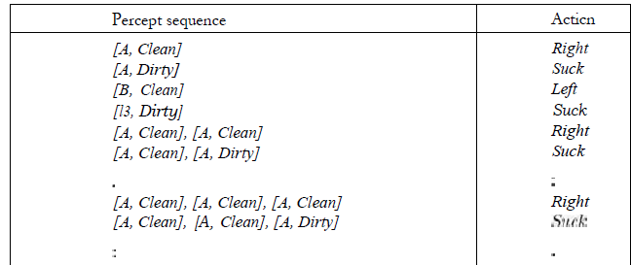
Simple reflex agents Example

Slide 40
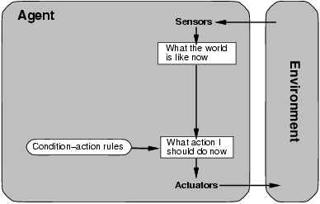
Simple reflex agents

Slide 41
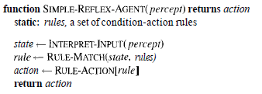
The INTERPRET-INPUT function generates an abstract description of the current state from the percept
RULE-MATCH function returns the first rule in the set of rules that matches the given state description

Slide 42
Simple reflex agents have the admirable property of being simple, but they turn out to be of very limited intelligence (The correct decision can be made on the basis of only the current percept i.e., environment is fully observable)
Even a little bit of unobservability can cause serious trouble (They do not have knowledge of non-perceptual parts of the current state)
Mostly too big to generate and to store.
Not adaptive to changes in the environment.

Slide 43
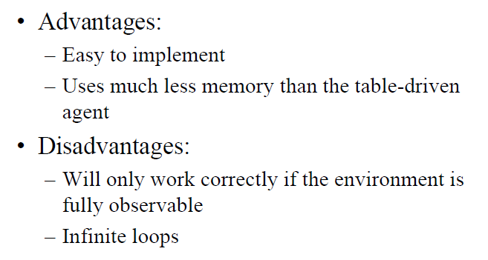

Slide 44
Model-based reflex agents
The Model-based agent can work in a partially observable environment, and track the situation.
A model-based agent has two important factors:
Model: It is knowledge about "how things happen in the world," so it is called a Model-based agent.
Internal State: It is a representation of the current state based on percept history.

Slide 45
Model-based reflex agents
It works by finding a rule whose condition matches the current situation.
A model-based agent can handle partially observable environments by use of model about the world.
The agent has to keep track of internal state which is adjusted by each percept and that depends on the percept history.
The current state is stored inside the agent which maintains some kind of structure describing the part of the world which cannot be seen.

Slide 46
Model-based reflex agents
The agent should maintain some sort of internal state that depends on the percept history and thereby reflects at least some of the unobserved aspect of the current state
Updating this internal state information requires two kinds of knowledge to be encoded in the agent program
Information about how the world evolves independently of the agent
Information about how the agent’s own actions affect the world

Slide 47
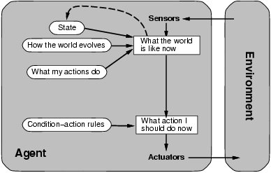
Model-based reflex agents

Slide 48
Model-based reflex agents
These agents have the model, "which is knowledge of the world" and based on the model they perform actions.
Updating the agent state requires information about:
How the world evolves
How the agent's action affects the world.

Slide 49
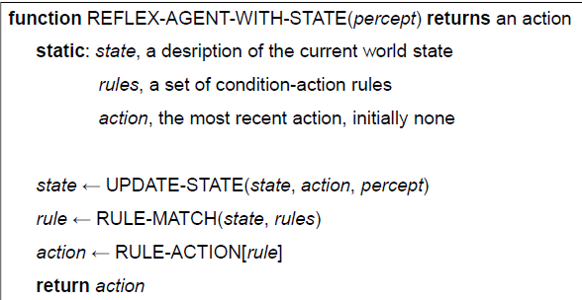
The above said state information is implemented in simple Boolean circuits or in complete scientific theories called model of the world
An agent that uses such a model is called a model-based agent

Slide 50
Goal-based agents
Goal information guides agent’s actions (looks to the future)
Sometimes achieving goal is simple eg. from a single action
Other times, goal requires reasoning about long sequences of actions
Flexible: simply reprogram the agent by changing goals

Slide 51
Goal-based agents
The knowledge of the current state environment is not always sufficient to decide for an agent to what to do.
The agent needs to know its goal which describes desirable situations.
Goal-based agents expand the capabilities of the model-based agent by having the "goal" information.
They choose an action, so that they can achieve the goal.
These agents may have to consider a long sequence of possible actions before deciding whether the goal is achieved or not. Such considerations of different scenario are called searching and planning, which makes an agent proactive.

Slide 52
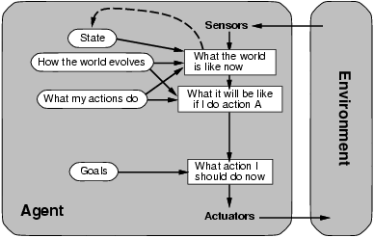
Goal-based agents

Slide 53
Utility-based agents
What if there are many paths to the goal?
Utility measures which states are preferable to other state
Maps state to real number (utility or “happiness”)

Slide 54
Utility-based agents
These agents are similar to the goal-based agent but provide an extra component of utility measurement which makes them different by providing a measure of success at a given state.
Utility-based agent act based not only goals but also the best way to achieve the goal.
The Utility-based agent is useful when there are multiple possible alternatives, and an agent has to choose in order to perform the best action.
The utility function maps each state to a real number to check how efficiently each action achieves the goals.

Slide 55
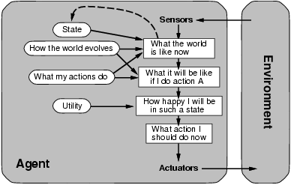
Utility-based agents

Slide 56
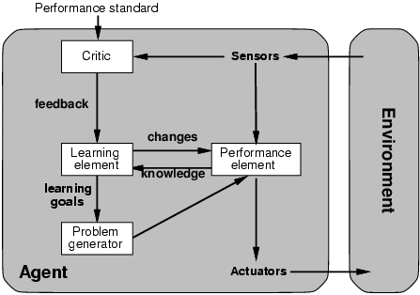
Learning agents

Slide 57
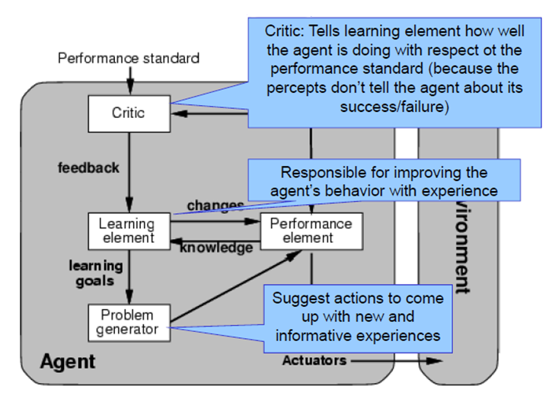
Learning agents

Slide 58
Learning agents
A learning agent in AI is the type of agent which can learn from its past experiences, or it has learning capabilities.
It starts to act with basic knowledge and then able to act and adapt automatically through learning.
A learning agent has mainly four conceptual components, which are:
Learning element: It is responsible for making improvements by learning from environment
Critic: Learning element takes feedback from critic which describes that how well the agent is doing with respect to a fixed performance standard.
Performance element: It is responsible for selecting external action
Problem generator: This component is responsible for suggesting actions that will lead to new and informative experiences.
Hence, learning agents are able to learn, analyze performance, and look for new ways to improve the performance.

